Slide 1
Dependency Inversion Principle Guiced Up

Slide 2
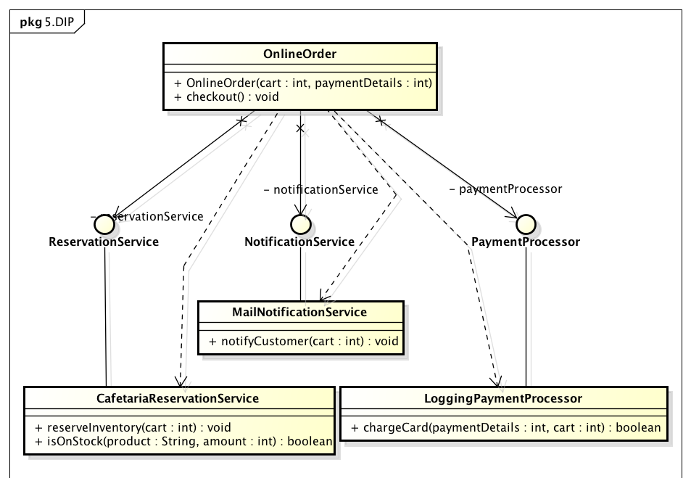
Case: OrderService
Notes:
Laat de studenten eerst het DIP implementeren zonder framework. Later in de les Guice gebruiken.

Slide 3
Problem solved?!
We decoupled our Order classes from the implementations of their dependencies.
Problem: Now we have to set all dependencies manually ☹

Slide 4
Inversion of control

Slide 5
Inversion of Control (IOC)
Instead of objects invoking other objects, the dependent objects are added through an external entity/container.
Inversion of Control is the general style of using Dependency Injection to wire the objects in an application.
Also known as the Hollywood principle – “don’t call me I will call you”.
IoC is all about Object dependencies.
Prevents hard-coded object creation and object/service lookup.
Loose coupling
Helps write effective unit tests.

Slide 6
Inversion of Control (IOC)
Traditional "Pull" approach:
Direct instantiation
Asking a Factory for an implementation
"Push" approach:
Something outside of the object "pushes" its dependencies into it. The object has no knowledge of how it gets its dependencies, it just assumes they are there.
The "Push" approach is called "Dependency Injection".

Slide 7
Dependency Injection
Dependency injection is a style of object configuration in which an objects fields and collaborators are set by an external entity.
Dependency Injection is the act of injecting dependencies into an Object.
Dependencies are “injected” by container during runtime.
Beans define their dependencies through constructor arguments or properties

Slide 8
Why is Dependency Injection better?
Loose Coupling is achieved because you don't hard-code dependencies between layers and modules. Instead you configure them outside of the code. This makes it easy to swap in a new implementation of a service, or break off a module and reuse it elsewhere.
Testability is improved because your objects don't know or care what environment they're in as long as someone injects their dependencies. Hence you can deploy objects into a test environment and inject mocks for their dependencies with ease.

Slide 9
DI containers
Dependency Injection (DI) or Inversion of Control (IoC)

Slide 10
What is a DI (IoC) Container?
Creates objects that are ready for you to use
Knows how to create objects and their dependencies
Knows how to initialize objects when they are created (if necessary)

Slide 11
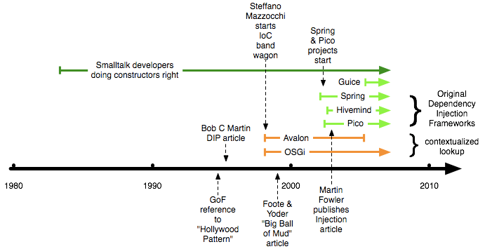
History

Slide 12
DI Containers
Java
CDI, EJB, Spring, Guice
.NET choices:
Unity, Castle Windsor, Spring.NET
Ruby
DI is integral part of the language, containers are not needed
Notes:
Java: Spring
Ruby: we don’t need no stinkin’ DI containers!

Slide 13
DI Container Rules
Don’t “new” up anything that is a dependency
Don’t new up classes that you want to create a fake in a test
Do new up entity objects
Do new up value types (e.g. String, DateTime, etc.)
Do new up Java API types (e.g. Connection)
Entity objects should not have dependencies
If you have to have static variables, isolate them behind the DI container (e.g. example in previous slide)
Mock the DI container when writing unit tests

Slide 14
CDI
DI in Java EE

Slide 15
What is CDI?
Bindings are code based
Bindings are code or XML based
Type-safe DI framework (based on Seam, Guice and Spring) for Java EE
Uses javax.inject as a base API

Slide 16
Implementations, web profile
Three implementations: JBoss Weld, Apache OpenWebBeans and Resin CanDI
Only one stable at the moment – Weld, used in Glassfish and JBoss AS
JavaEE 6 has the so-called „profiles“. CDI is part of the „Web profile“
CDI implementations are not limited to application servers (with the help of extensions)
Tomcat does not fully implement the “Web profile”, so we’ll pick Guice as an implementation of the CDI API.

Slide 17
Injection targets for Java EE
Inject into:
POJOs
Servlets
REST Services
Injection candidates:
POJOs
Factories
DAOs
…

Slide 18
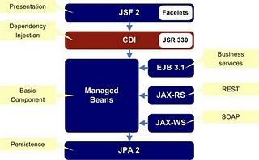
Java EE structure with CDI

Slide 19
Injection
@javax.inject.Inject is used:
The „dao“ field is called „injection point“. Injection point types are:
Field
Constructor
Setter
Initializer
public class OrdersBean {
@Inject private OrdersDao dao;
}

Slide 20
Injection points
public class OrdersBean {
@Inject private OrdersDao dao;
@Inject
public OrdersBean(OrdersDao dao){}
@Inject
public void init(OrdersDao dao) {}
@Inject
public void setOrdersDao(OrdersDao dao){}
}

Slide 21
(Google) GUICE
A simple approach to DI

Slide 22
Guice – Supplier
Supplier code (using annotations):
@Inject can be applied to:
Constructors
Methods
All methods annotated with @Inject will be invoked after the object’s instantiation
Fields (not recommended)
class MyBillingService implements BillingService {
private final CreditCardProcessor processor;
@Inject
public MyBillingService(CreditCardProcessor p) {
processor = p;
}
…
}
That’s it! Use javax.inject.Inject to stay compatible with CDI

Slide 23
Guice – Complex Dependencies
Dependencies can also be complex to create:
BankAccount may have dependencies of its own
TxApprover may be an interface
class VisaCreditCardProcessor implements CreditCardProcessor {
private final BankAccount account;
private final TxApprover txApprover;
@Inject
public VisaCreditCardProcessor(BankAccount a, TxApprover t) {
account = a;
txApprover = t;
}
…
}

Slide 24
Guice – Module
Dependencies are described in a separate Module class:
Client code is now:
Guice will recursively build the requested binding objects
In this case a MyBillingService object will be created with DatabaseTxLog and a VisaProcessor
public class BillingModule extends AbstractModule {
@Override
protected void configure() {
bind(CreditCardProcessor.class).to(VisaCreditCardProcessor.class);
bind(TxApprover.class).to(VisaIsraelTxApprover.class);
bind(BillingService.class).to(MyBillingService.class);
}
}
Injector injector = Guice.createInjector(new BillingModule());
BillingService billingService = injector.getInstance(BillingService.class);

Slide 25
Guice advanced binding
Can bind concrete types by:
Type
Name
Annotation
Can bind to:
A class (new instance every time)
An object (a specific instance)
Generic classes

Slide 26
Binding constants using @Named
We can use an annotation “shortcut” using @Named
Bind to specific constant object (instantiated only once)
class SqlTxLog {
@Inject
public SqlTxLog(@Named(″JDBC URL″) String connectionURL,
@Named(″login timeout seconds″) Integer timeout)
{ … }
}
public class SqlTxLogModule extends AbstractModule {
@Override
protected void configure() {
bind(String.class)
.annotatedWith(Names.named("JDBC URL"))
.toInstance("jdbc:mysql://localhost/pizza");
bind(Integer.class)
.annotatedWith(Names.named(″login timeout seconds”))
.toInstance(10);
}
}
Notes:
Alternatief voor property files?

Slide 27
More on Binding to Instance
There are two ways to bind an instance:
Using .toInstance passing an instance
Using .to(SomeClass.class).in(Singleton.class)
A single instance is created by Guice
Dependencies are injected according to the Module
We can also use @Singleton on the bound class
bind(String.class)
.annotatedWith(Names.named("login timeout seconds"))
.toInstance("10");
bind(BillingService.class)
.to(MyBillingService.class).in(Singleton.class);

Slide 28
Guice in a Servlet or Jersey Environment
CDI works out of the box in a Java EE container like Glassfish but we have to enable Guice for Tomcat
For Servlets to use Guice DI:
Create a WebFilter
Create a WebListener
For JAX RX to use Guice DI:
Adjust your ResourceConfig

Slide 29
WebFilter
This tells the Servlet Container to re-route all requests through GuiceFilter
@WebFilter("/*")
public class GuiceWebFilter extends GuiceFilter {
@Override
public void doFilter(
ServletRequest servletRequest,
ServletResponse servletResponse,
FilterChain filterChain) throws
IOException, ServletException {
super.doFilter(
servletRequest,
servletResponse,
filterChain);
}
}

Slide 30
WebListener
A ServletContextListener is a Java servlet component that is triggered as soon as a web application is deployed, and before any requests begin to arrive.
@WebListener
public class GuiceServletConfig extends GuiceServletContextListener {
@Override
protected Injector getInjector() {
return Guice.createInjector(
new MyServletModule());
}
}
extends ServletModule (which in fact extends AbstractModel)

Slide 31
ServletModule
public class MyServletModule extends ServletModule {
@Override
protected void configureServlets() {
super.configureServlets();
serve("/viewItems")
.with(ViewItemsPageController.class);
bind(ItemService.class)
.to(LocalItemService.class);
bind(ItemDAO.class).
to(ItemJdbcDAO.class);
}
}
You can remove the urlPattern from your WebServlets
PageController implemented by a Servlet
Ordinary binding of interfaces to implementations

Slide 32
Adjust ResourceConfig class for Guice in JAX RS (Jersey)
@ApplicationPath("/rest")
class RestResourceConfig extends ResourceConfig {
@Inject
public RestResourceConfig(
ServiceLocator serviceLocator) {
packages("oose.dea.services.rest");
GuiceBridge.getGuiceBridge().
initializeGuiceBridge(serviceLocator);
GuiceIntoHK2Bridge guiceBridge =
serviceLocator.getService(
GuiceIntoHK2Bridge.class);
guiceBridge.bridgeGuiceInjector(
Guice.createInjector(
new MyServletModule()));
}
}
Part of HK2, the proprietary DI solution provided by Jersey
HK2 has a “bridge” to bypass HK2 and enable Guice.

Slide 33
How to add Guice to a Java EE Application
Maven dependencies:
<dependency>
<groupId>org.glassfish.hk2</groupId>
<artifactId>guice-bridge</artifactId>
<version>2.4.0-b25</version>
</dependency>
<dependency>
<groupId>com.google.inject.extensions</groupId>
<artifactId>guice-servlet</artifactId>
<version>4.0</version>
</dependency>
<dependency>
<groupId>com.google.inject</groupId>
<artifactId>guice</artifactId>
<version>4.0</version>
</dependency>

Slide 34
Outcome
What we’ve achieved?
Both client and supplier are decoupled from implementation details
All dependency logic is executed at runtime and is contained in Modules
A module encapsulates all creation logic in our program
Testing & Mocking is easy – since we’re essentially using constructor injection
Side-note:
Other DI frameworks (e.g. Spring) use XML files to define dependencies
This enables changing the code’s behaviour without recompiling
But it also has its disadvantages (e.g. it’s not type safe)
Writing fake implementations of dependencies only for test purposes

Slide 35
Dependency Injection – Is it really that important?
If we want to write real units tests, then we have to isolate our units
If we want to isolate our units, then we have to use mocks
If we want to use mocks, we have to inject them somehow
But we aren’t doing it (just) for the tests!
If we use dependency injection, our code is less coupled, more modular, robust, and reusable, cohesive, cleaner and DRYer.
Remember: Testable Code => Better Code!
Unit Tests
Mock objects
Dependency
Injection

Slide 36
Case: OrderService (revisited)
Build a simple client using Guice to wire all dependencies for creating a new OnlineOrder instance.

